Slide 1
Social Advertising Page Access - A Guide.
January 2025

Slide 2
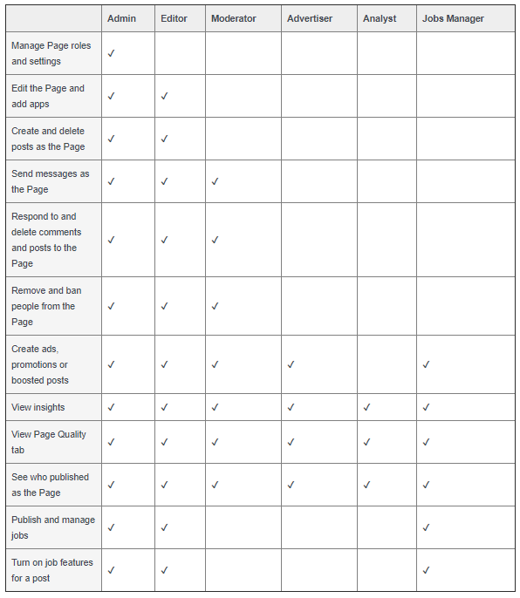
What level of access does carsalesXT need?
carsalesXT requires Advertiser Access to run campaigns via your Facebook page.
Advertiser access gives us permission to run ads via your Facebook page, but won’t allow us to create or delete posts, respond to correspondence and change page access for others.
For more information on page roles, please go to https://www.facebook.com/help/PageRoles

Slide 3
How to accept a carsalesXT Page Access request
Before you start, we recommend checking
Your Meta Business Page is verified and has a Page Owner.
You are logged in to the Business page.
You are the Page Owner (only Page Owners can accept new requests).
If you are connected to a Meta Business Manager, you will need to be the Business Admin and admin to the Business that is the Page Owner.
You are doing so on Desktop (page access can only be accepted on desktop).
Note, you cannot accept a request through Meta Business Suite.

Slide 4
How to accept a carsalesXT Page Access Request.
If you have full control there are two ways to accept Page Access Request
1. You can approve access requests from your Page
2. You can approve requests in Meta Business Manager
Both are outlined here in this Meta Support article: https://www.facebook.com/business/help/619744345300739

Slide 5
FAQ
What if I don’t have the right admin rights to accept the carsalesXT Facebook access request? Please reach out to Meta Business Help, they will be able to provide you information in getting the right access. https://www.facebook.com/business/help
Is carsalesXT able to contact Meta on my behalf?
As carsalesXT is not the business manager, page owner or admin, we will be unable to contact Meta on your behalf due to privacy.
What if I am not getting the right help from Meta?
Sometimes Meta may not be able to assist due to security and privacy issues with the page, depending on your circumstance. This can sometimes happen, for example, when people leave the business and do not hand over admin rights or page ownership. We would suggest considering creating a new business Facebook page, as this will allow you to have the right access, which may help with issues down the track and keep your page secure from people outside of your business.
I have tried everything to give carsalesXT access to my page, nothing has worked, what now? carsalesXT has some alternative solutions if you are having problems giving us access to your Facebook page. See below alternatives, for more information please contact your carsales Account Manager. Stock Extend
We can use the carsales Facebook page in place of your brand page. Please note, the click through must be back to the carsales webpage, not your brand website, due to the way the product is designed.
We have a Display Stock Extend option, which we place across our premium brand-safe white-listed sites, rather then on Social media.
Newsfeed
We have several products available that we can allocate. Reach out to your carsales Account Manager for more information.

Slide 6
Thank you.

